Slide 1
CS2523 Computer Organisation and Assembly Language
Assembly Program - Write, Assemble, Execute, and Debug

Slide 2
In this lecture we will learn…
Write
Assemble
Debug
Execute

Slide 3
Assembler
NASM
The Netwide Assembler

Slide 4
Linker
ALINK
Notes:
Linking object to make it executable as object code is its self not executable so the linker is used to convert it into an executable.

Slide 5
Debugger
AFD
Advanced Full Screen Debug

Slide 6
My First Assembly Program:
Write a program in assembly that calculates the sum of squares of 2 and 3…
by adding through registers…
Restriction: You can only use addition and subtraction in registers.
You cannot use multiplication.

Slide 7
fir.asm
[org 0x100]
mov ax, 2
add ax, 2
mov bx, 3
add bx, 3
add bx, 3
add ax, bx
mov ax, 0x4c00
int 0x21

Slide 8
Commands to execute the code
cls – to clear screen of DOSBox
mount m: path of directory where assembly code is placed. e.g. mount m: d:\assembly
m:
dir – to display files of directory m
Assemble –
nasm first.asm –o fir.com
Execute
fir.com [No output; since we have not displayed anything on screen]

Slide 9
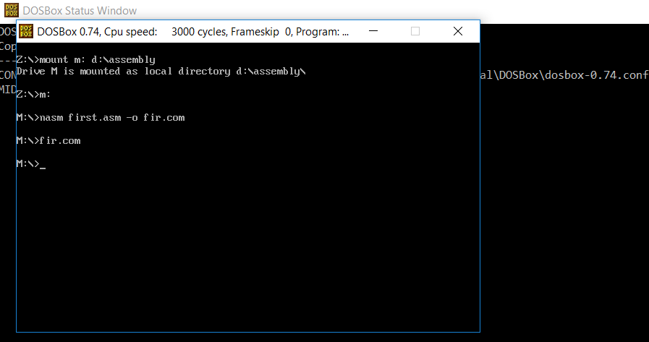
Commands to execute the code

Slide 10
Word Representation
When we have number of 16 bit or greater than we have to decide how to place the number in the memory which means that what will be the byte order.
Either
Intel uses little endian Notation which means that lesser significant byte at lesser address.
For the example of assembly code
The instruction add ax,bx the value shown by the fir.lst is 01D8 this is a two byte instruction and 01 is the opcode of add and the D8 shows two registers ie ax,bx
Generally we can not change the values of these two registers
Notes:
When we have number of 16 bit or greater than we have to decide how to place the number in the memory which means that what will be the byte order.
Either
Intel uses little endian Notation which means that lesser significant byte at lesser address.
For the example of assembly code
The instruction add ax,bx the value shown by the ex01.lst is 01D8 this is a two byte instruction and 01 is the opcode off add and the DB shows two registers ie ax,bx
Generally we can not change the values of these two registers

Slide 11
Word Representation
4 Byte Word
Representation in Memory
MSB
LSB
Representation 1
Little Endian Notation
MSB
LSB
0 1 2 3
Representation 2
Big Endian Notation
LSB
MSB
0 1 2 3
Notes:
When we have number of 16 bit or greater than we have to decide how to place the number in the memory which means that what will be the byte order.
Either
Intel uses little endian Notation which means that lesser significant byte at lesser address.
For the example of assembly code
The instruction add ax,bx the value shown by the ex01.lst is 01D8 this is a two byte instruction and 01 is the opcode off add and the DB shows two registers ie ax,bx
Generally we can not change the values of these two registers

Slide 12
Commands to execute the code
Listing File –
Create: nasm first.asm –l firstlist.lst
View: type firstlist.lst

Slide 13
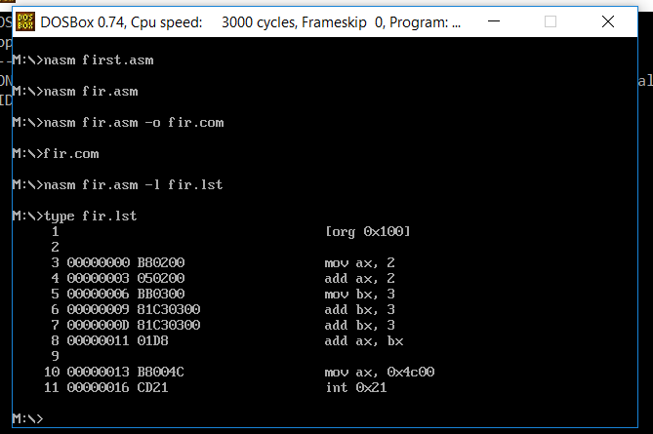
fir.lst: Word Representation (Little Endian, Big Endian)

Slide 14
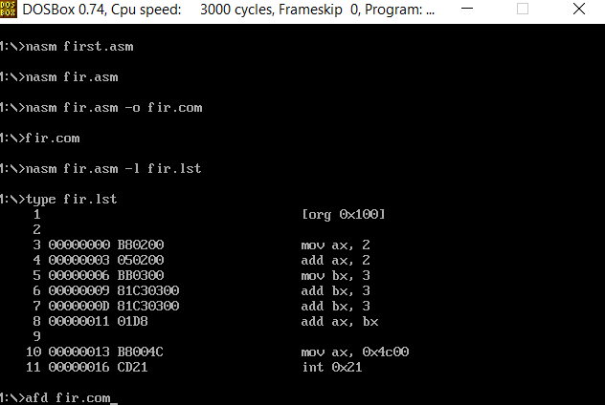
fir.lst: Addresses in Hexadecimal

Slide 15
Commands to debug the code
Debugger – If we want to see the value of registers we use debugger. We’ll use AFD Debugger. AFD stands for Advanced Full Screen Debugger.
Command to open Debugger
afd fir.com
To execute the program’s instructions one by one
Tow keys are used to execute instructions step by step
F1 and F2

Slide 16
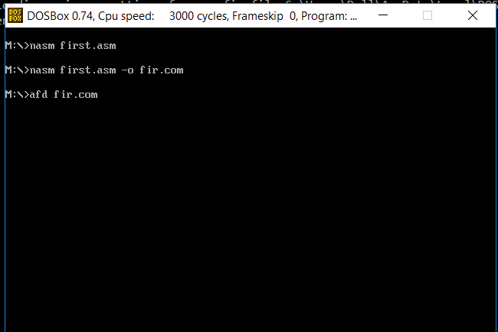
Commands to debug the code

Slide 17
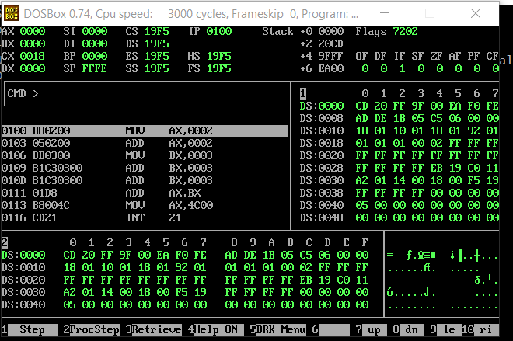
Debugger: Step by step execution

Slide 18
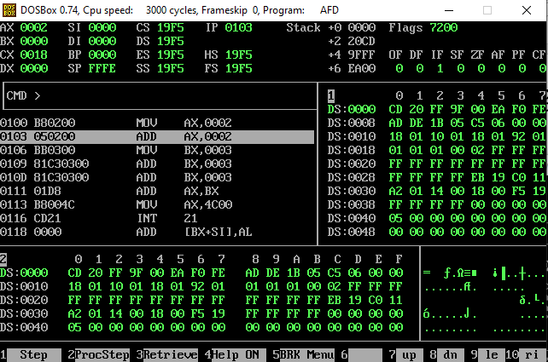
Debugger: After pressing F1 or F2

Slide 19
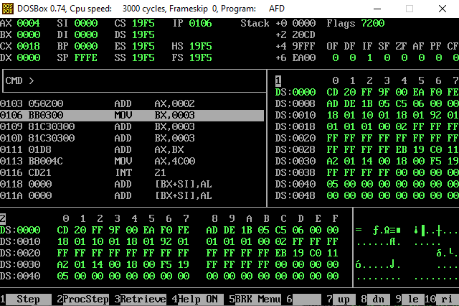
Debugger: After pressing F1 or F2

Slide 20
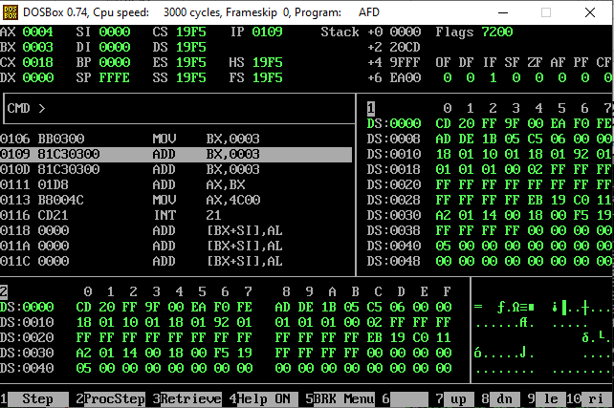
Debugger: After pressing F1 or F2

Slide 21
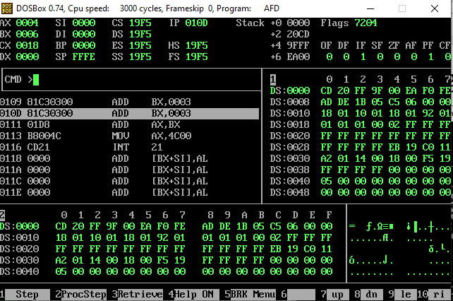
Debugger: After pressing F1 or F2

Slide 22
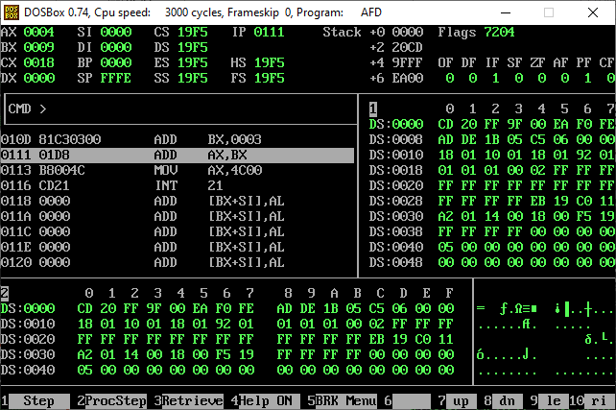
Debugger: After pressing F1 or F2

Slide 23
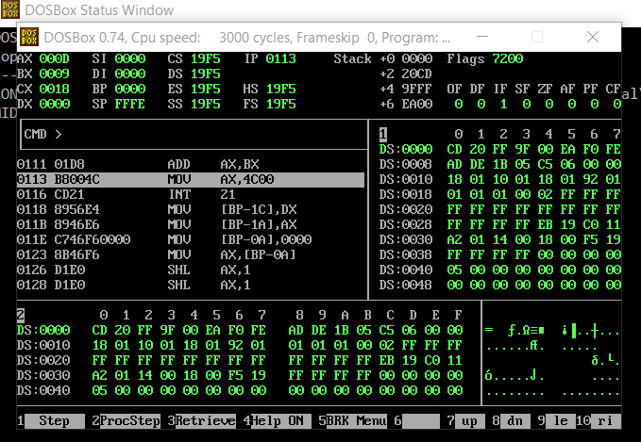
Debugger: After pressing F1 or F2

Slide 24
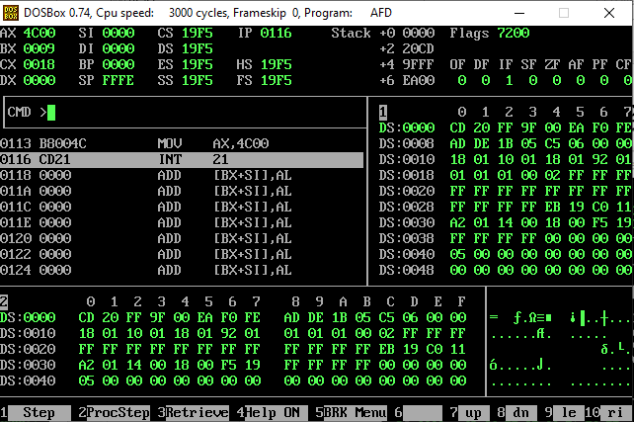
Debugger: After pressing F1 or F2

Slide 25
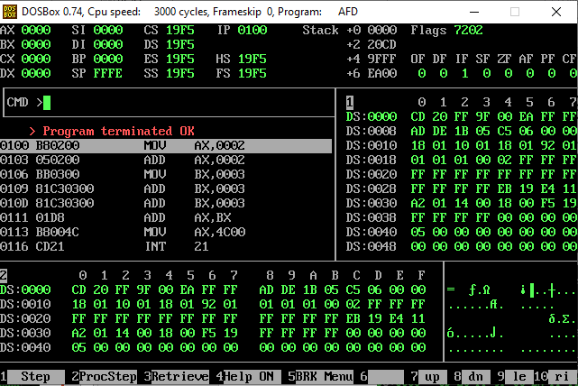
Debugger: After pressing F1 or F2

Slide 26
How values of registers are updating???
[org 0x100]
mov ax, 2
add ax, 2
mov bx, 3
add bx, 3
add bx, 3
add ax, bx
mov ax, 0x4c00
int 0x21
2
RAM
mov ax, 2
add ax, 2
mov bx, 3
add bx, 3
add bx, 3
add ax, bx
100
103
105
108
110
112
AX
BX

Slide 27
How values of registers are updating???
[org 0x100]
mov ax, 2
add ax, 2
mov bx, 3
add bx, 3
add bx, 3
add ax, bx
mov ax, 0x4c00
int 0x21
4
RAM
mov ax, 2
add ax, 2
mov bx, 3
add bx, 3
add bx, 3
add ax, bx
100
103
105
108
110
112
AX
BX

Slide 28
How values of registers are updating???
[org 0x100]
mov ax, 2
add ax, 2
mov bx, 3
add bx, 3
add bx, 3
add ax, bx
mov ax, 0x4c00
int 0x21
4
RAM
mov ax, 2
add ax, 2
mov bx, 3
add bx, 3
add bx, 3
add ax, bx
100
103
105
108
110
112
AX
3
BX

Slide 29
How values of registers are updating???
[org 0x100]
mov ax, 2
add ax, 2
mov bx, 3
add bx, 3
add bx, 3
add ax, bx
mov ax, 0x4c00
int 0x21
4
RAM
mov ax, 2
add ax, 2
mov bx, 3
add bx, 3
add bx, 3
add ax, bx
100
103
105
108
110
112
AX
6
BX

Slide 30
How values of registers are updating???
[org 0x100]
mov ax, 2
add ax, 2
mov bx, 3
add bx, 3
add bx, 3
add ax, bx
mov ax, 0x4c00
int 0x21
4
RAM
mov ax, 2
add ax, 2
mov bx, 3
add bx, 3
add bx, 3
add ax, bx
100
103
105
108
110
112
AX
9
BX

Slide 31
How values of registers are updating???
[org 0x100]
mov ax, 2
add ax, 2
mov bx, 3
add bx, 3
add bx, 3
add ax, bx
mov ax, 0x4c00
int 0x21
13
RAM
mov ax, 2
add ax, 2
mov bx, 3
add bx, 3
add bx, 3
add ax, bx
100
103
105
108
110
112
AX
9
BX

Slide 32
How values of registers are updating???
[org 0x100]
mov ax, 2
add ax, 2
mov bx, 3
add bx, 3
add bx, 3
add ax, bx
mov ax, 0x4c00
int 0x21
13
RAM
100
103
105
108
110
112
AX
9
BX

Slide 33
Questions

Slide 34
Question:1
[org 0x100]
mov ax, 3
add ax, 1
mov ax, 2
mov bx, 3
sub bx, ax
add ax, bx
mov ax, 0x4c00
int 0x21

Slide 35
Question:2
[org 0x100]
mov ax, 2
mov bx, 1
sub ax, bx
add ax, bx
add ax, bx
mov ax, 4
mov cx, 4
mov ax, 0x4c00
int 0x21

Slide 36
Question:3
[org 0x100]
mov ax, 2
mov cx, 4
mov dx, 1
add cx, dx
add ax, dx
sub cx, dx
add dx, ax
mov bx, 8
mov ax, 0x4c00
int 0x21

